Slide 1
Account Aggregation And The Role Of Technology Platform In It
Samir Kishor Parmar
Graduation Course :- B.E Computer Engineering

Slide 2
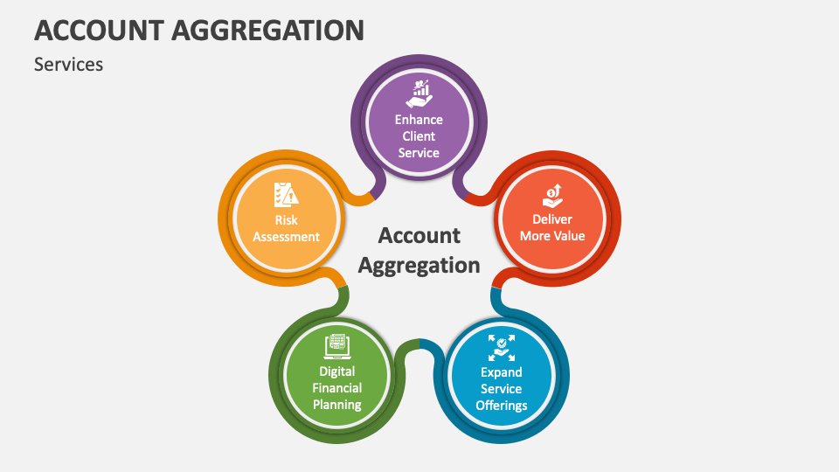
What is Account Aggregation ?
Account aggregation is the process of collecting and consolidating financial data from multiple sources, such as bank accounts, credit cards, investment portfolios, and insurance policies, into a single, centralized location. This process is typically facilitated by technology platforms that utilize open banking protocols to securely access and share customer financial information with authorized third-party applications.

Slide 3
How does Account Aggregation Works?
1) User Initiates Account Aggregation: A user initiates the account aggregation process by providing their login credentials for their various financial accounts to a trusted account aggregator platform.
2) Secure Data Retrieval: The account aggregator platform securely retrieves financial data from each connected financial institution using open banking APIs. These APIs adhere to strict security standards to protect sensitive financial information.
3) Data Aggregation and Analysis: Once collected, financial data is aggregated into a unified format, enabling users to view a holistic picture of their financial standing across multiple institutions. Technology platforms often provide data analysis tools that help users gain insights into their spending patterns, identify areas for potential savings, and make informed financial decisions.
4) Data Sharing with Consent: With user consent, aggregated financial data can be shared with authorized third-party applications, such as personal finance apps, lending institutions, and investment platforms. This enables users to access a wider range of financial services and tailored financial recommendations.

Slide 4
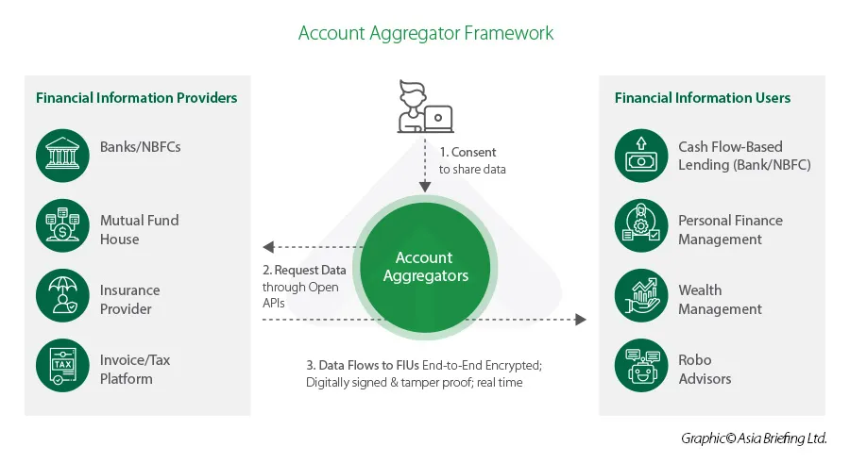
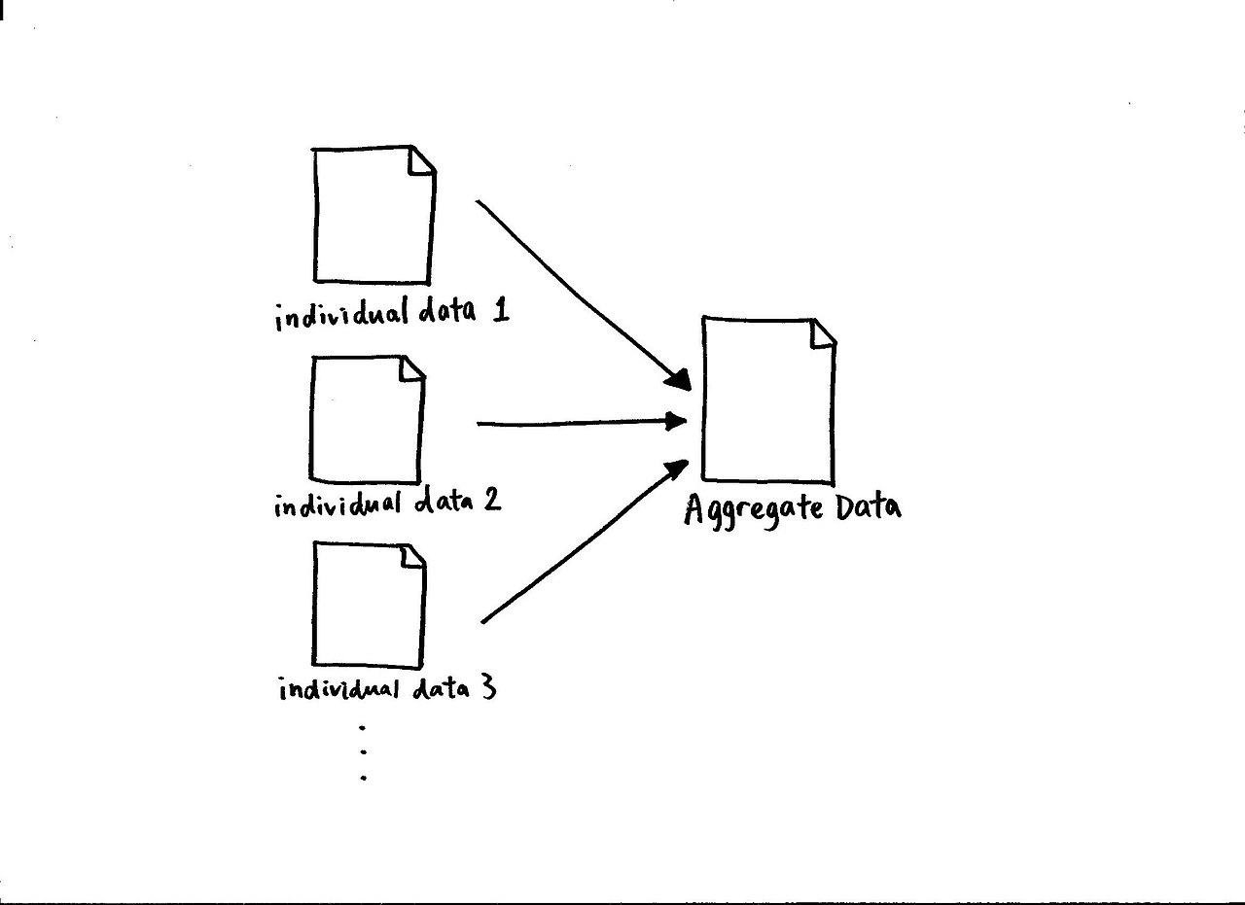
Working Process of Account Aggregation

Slide 5
Benefits of Account Aggregation
Consumers:
Centralized Financial Overview: Gain a comprehensive view of their financial situation by consolidating data from multiple sources.
Improved Financial Management: Track spending, identify savings opportunities, and make informed financial decisions.
Personalized Financial Recommendations: Receive personalized financial advice based on their aggregated financial data.
Businesses:
Streamlined Financial Data Access: Securely access and analyze customer financial data to enhance risk assessment and underwriting processes.
Enhanced Customer Experience: Offer personalized financial products and services tailored to individual customer needs.
Reduced Operational Costs: Automate manual data collection and verification tasks, leading to cost savings.

Slide 6
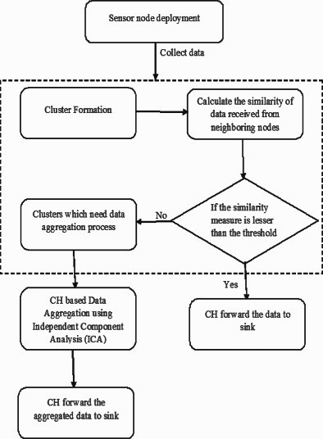
Flowchart of Data Aggregation Process (data used for account aggregation): -

Slide 7
Roles of Technology Platforms in Account Aggregation Process: -
Provide the infrastructure and tools necessary to securely collect, manage, and share financial data.
Data Collection and Aggregation: Collect financial data from multiple sources, aggregate it into a unified format, and store it securely.
Data Analysis and Visualization: Provide data analysis tools and visualizations to help users gain insights into their financial data.
Data Sharing and Access Controls: Facilitate secure data sharing with authorized third-party applications based on user consent.
Open Banking Integration: Utilize open banking APIs to securely connect with financial institutions and retrieve customer data.

Slide 8
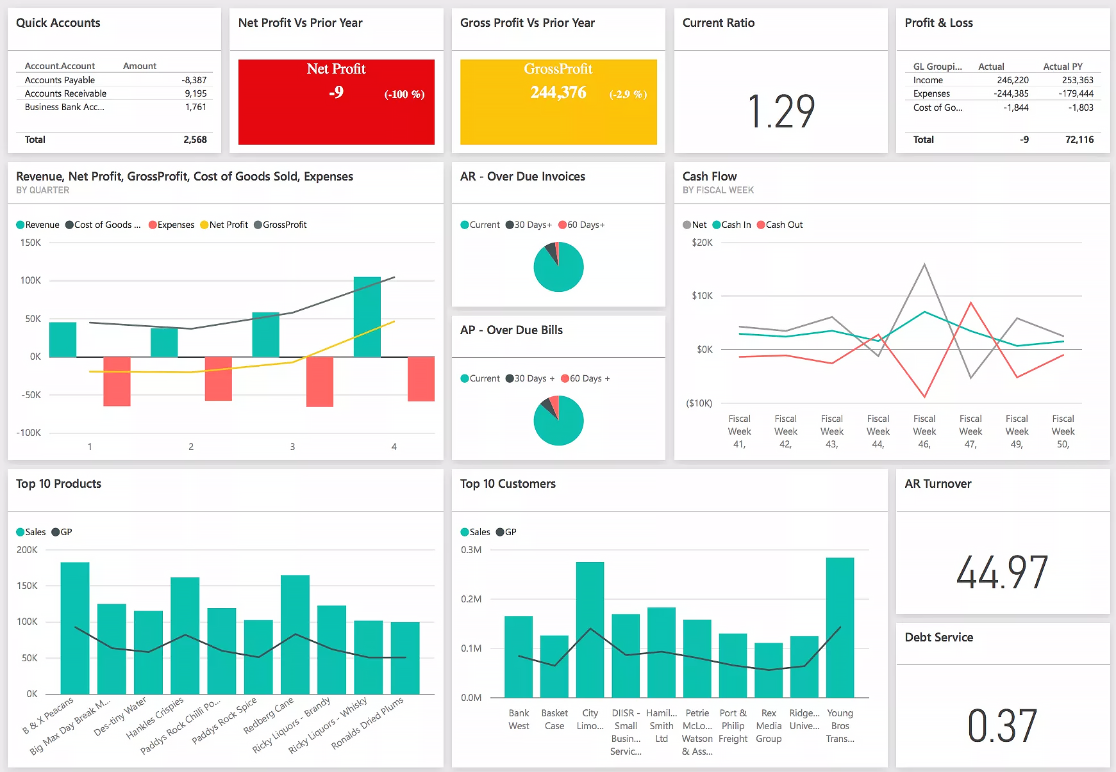
Financial Data Visualization(collected using account aggregation):

Slide 9
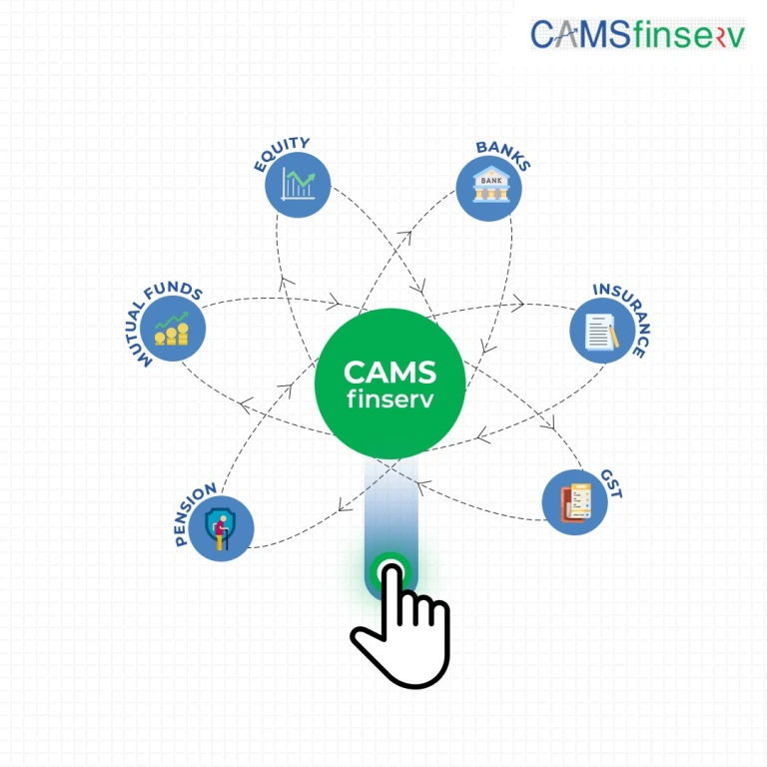
Example of Account Aggregation Technology Platform :-
CAMS finserv is one of the examples of account aggregation technology platform :-
Bank Statement Analyser: - CAMS finserv not only assembles all these details, including the history, in one place, its ‘Bank Statement Analyser’ feature also analyses the different account statements and breaks them into meaningful and consumable information.
Money Manager: - Money management, which involves organically planning and managing one’s assets (FDs, equities, insurances, etc.), is a sought-after service today.Making client’s financial details streamlined and data tracking becomes easier.
Alerts on Upcoming Events: - It not just monitors the user’s bank statements, but on the basis of it, it can track necessary balance requirements and raise alerts about upcoming EMIs. This will help avoid bounces if the user doesn’t have the required money in their account.
Account Verification: - The CAMS finserv system easily replaces manual work of verification because it has all of the customer’s financial data(like Aadhar Card details,Pan Card details, EMI’s, Applied Schemes and etc) from their various accounts aggregated in one place. And this can be easily accessed by service providers with the consent of the customer.

Slide 10
Examples of Account Aggregation Technology Platforms: -
Personal Finance Apps: -
Mint
Personal Capital
YNAB
Lending Services: -
Upstart
SoFi
Financial Data Aggregators: -
Plaid
Envestnet Yodlee
Finicity

Slide 11
Sectors In Which Account Aggregation Is Used:-
Financial services: Account aggregation is a key component of many personal finance apps and services, which allow users to view their financial data from multiple institutions in one place. This can help users to track their spending, budget their money, and make better financial decisions.
Lending: Lenders are using account aggregation to assess creditworthiness and underwriting risk. By reviewing a borrower's financial data from multiple sources, lenders can get a more holistic view of their financial situation and make more informed lending decisions.
Insurance: Insurance companies are using account aggregation to develop personalized insurance products and services. For example, an insurance company might use account aggregation data to determine the appropriate level of auto insurance coverage for a customer.
Retail: Retailers are using account aggregation to offer personalized shopping experiences and targeted discounts. For example, a retailer might use account aggregation data to determine the most relevant products and promotions to offer a customer.
Healthcare: Healthcare providers are using account aggregation to improve patient care. For example, a doctor might use account aggregation data to identify potential health risks for a patient and provide preventive care.
Travel: Travel companies are using account aggregation to make it easier for travelers to book and manage their trips. For example, a travel company might use account aggregation data to pre-fill travel forms with a traveler's personal information.

Slide 12
Conclusion :-
Account aggregation, powered by technology platforms, is revolutionizing the way consumers and businesses interact with their financial data. By providing a centralized view of financial information, account aggregation empowers users to make informed financial decisions, improve financial management, and access a wider range of personalized financial services. As open banking technology continues to evolve, account aggregation is poised to play an even more significant role in the financial landscape.

Slide 13
THANK YOU

